Slide 1

EduBridge
“Placement Management System ”
Group Members
BONDRE AMRUTA
PATEL PRIYANKA
SANAP POOJA
in the guidance of
Ms. Amruta Deore

Slide 2
INDEX
Introduction
Problem Definition
Hardware and Software Requirement
Advantage and Disadvantage
Conclusion
References

Slide 3
INTRODUCTION
A Placement management system that consists of a student login, company login and an admin login.
The project is beneficial for college students, various companies visiting the campus for recruitment and even the college placement officer.
The software system allows the students to create their profiles and upload all their details including their marks onto the system.
The admin can check each student details and can remove faulty accounts.
The system also consists of a company login where various companies visiting the college can view a list of students in that college and also their respective resumes.

Slide 4
PROBLEM DEFINITION
System Analysis is the detailed study of the various operations performed by the system and their
relationships within and outside the system.
Analysis is the process of breaking something into its parts so that the whole may be understood.
System analysis is concerned with becoming aware of the problem, identifying the relevant and most
decisional variables,
analyzing and synthesizing the various factors and determining an optional or at least a satisfactory
solution.
During this a problem is identified, alternate system solutions are studied and recommendations are
made about committing the resources used to the system.

Slide 5
PURPOSE OF APP
maintain individual student record
maintain selection wise student detail
evaluting student performance
making only eligible student to take the test
allow online registration for online selection test
allow online request and support for the examination

Slide 6
MODULE NAME
ADMIN MODULE
STUDENT MODULE
REGISTRATION
APPLY FOR JOB
POST JOB MODULE
COMPANY MODULE

Slide 7
METHODOLOGY PROPOSED SYSTEM
Online Recruitment is aimed at developing a web-based and central recruitment Process system for the HR Group for a company.
Some features of this system will be creating vacancies, storing application data, and
Interview process initiation, Scheduling Interviews, Storing Interview results for the
applicant and finally hiring of the applicant.
This project Online Recruitment System is an online website in which jobseekers can
register themselves and then attend the exam.
Based on the outcome of the exam the jobseekers will be shortlisted.
The details of the examination & Date of the examination will be made available to
them through the website.
People all around the world can apply and register.
It has made all the process easy.

Slide 8
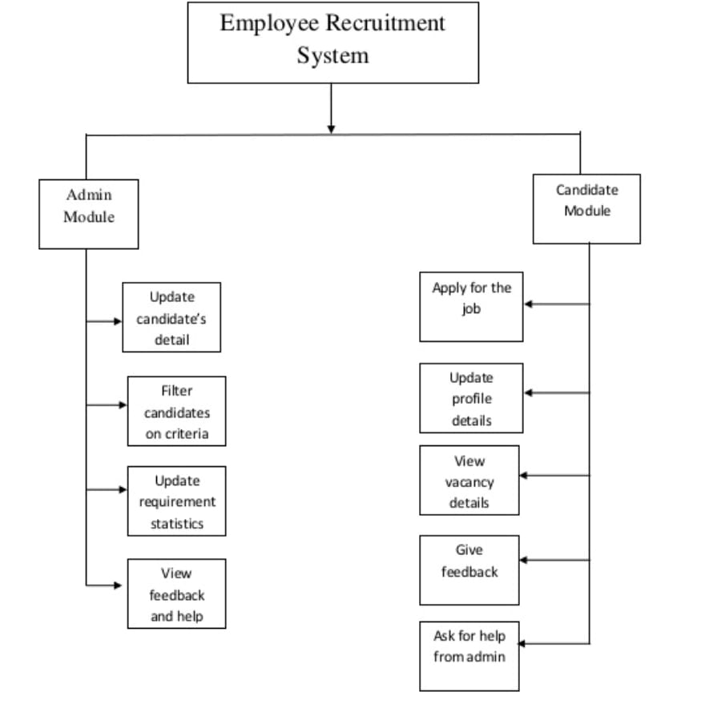
STRUCTURE DIAGRAM OF SYSTEM

Slide 9
FLOW CHART OF WHOLE SYSTEM
Start
Registration
Login
Verify
No
Enter Username & Password
Student
Yes
Admin
Company
Search Job
Manage Account
Post Job
UpDate webside
Take Test
Apply Job
Choose Student
Logout
Send Mail
Give Test
Stop
Logout

Slide 10
USE CASE DIADRAM OF SYSTEM
Registration
Login
Student
Apply for Job
Post Job
Manage Account
Admin
Send Mail
Exam
Company
Logout
Delete Profile
Update Profile

Slide 11
E-RDIAGRAM OF SYSTEM
Member
First Name
LastName
CName
ISA
SName
CID
Contact no
SID
Address
Email
UName
Password
College Name
COMPANY
Manage
Manage
ADMIN
STUDENT
Apply For
ContactNo
Address
Update
Post
Job
Rsult
Give
CID
Required Skill
SID
Exam
CID
CID

Slide 12
UML DIAGRAM OF SYSTEM
Login to System
Manage student details
Admin
Check role of acess
Manage College Detail
Forget Password
Check Credentials
Manage Module
Manage Qualification Detail
Manage Company Detail
Send Email to user
Manage Job Detail
Manage Placement Detail
Manage System Admin
Manage Rules of User
Manage User Permission
Manage Report
Second Level DFT-Campus Recruitment System

Slide 13
MVC Design Pattern
Modal
Updates
Manipulate
View
Controller
Sees
Uses
User

Slide 14
MVC
The Model contains only the pure application data, it contains no logic describing how to present the data to a user.
The View presents the model’s data to the user. The view knows how to access the model’s data, but it does not know what this data means or what the user can do to manipulate it.
The Controller exists between the view and the model. It listens to events triggered by the view (or another external source) and executes the appropriate reaction to these events. In most cases, the reaction is to call a method on the model. Since the view and the model are connected through a notification mechanism, the result of this action is then automatically reflected in the view.
The Model View Controller (MVC) design pattern specifies that an application consist of a data model, presentation information, and control information. The pattern requires that each of these be separated into different objects.
MVC is more of an architectural pattern, but not for complete application. MVC mostly relates to the UI / interaction layer of an application. You’re still going to need business logic layer, maybe some service layer and data access layer.

Slide 15

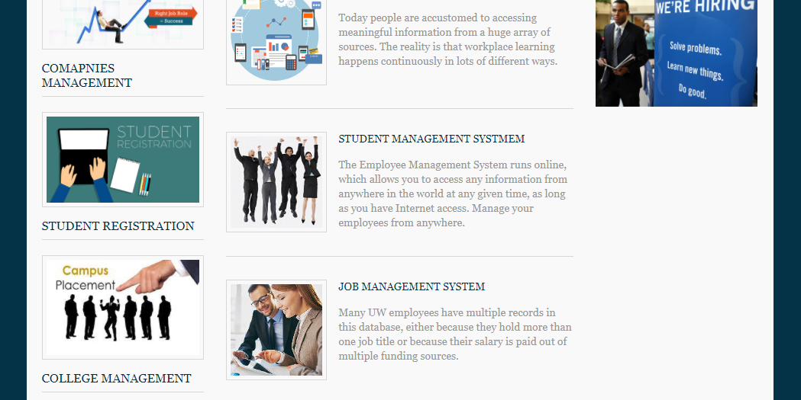
SCREENSHOT

Slide 16
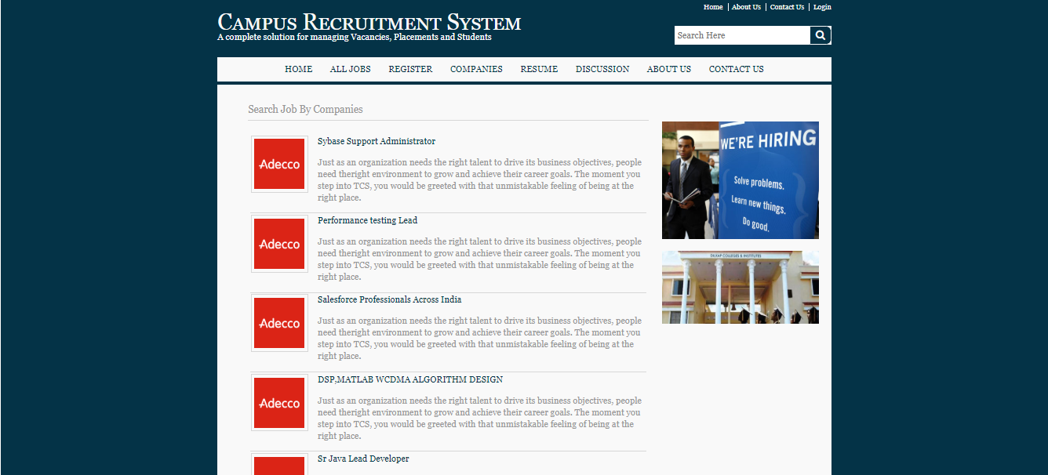
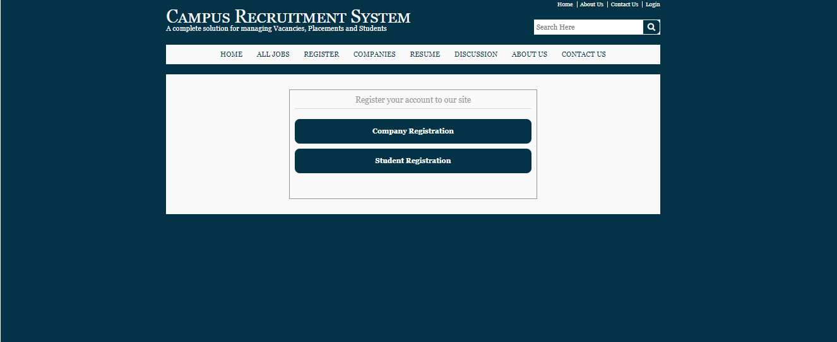

Slide 17
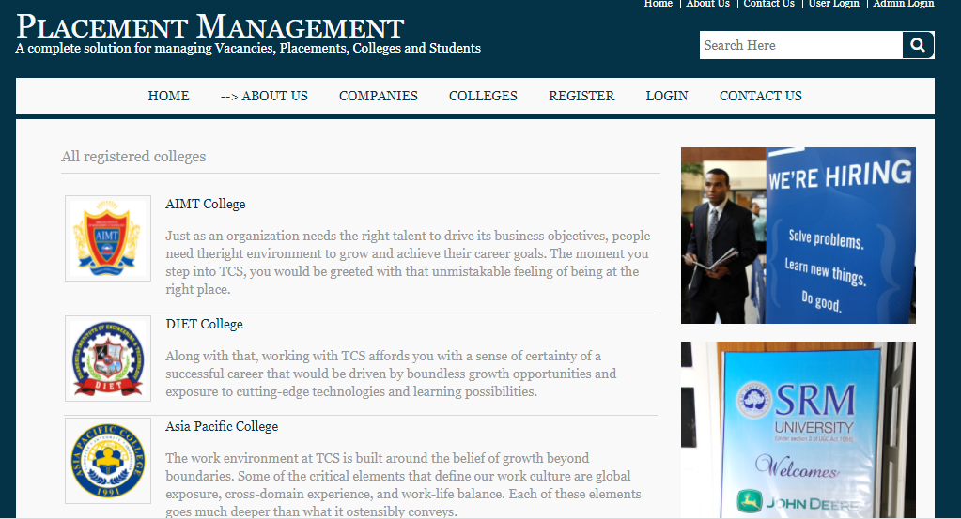

Slide 18
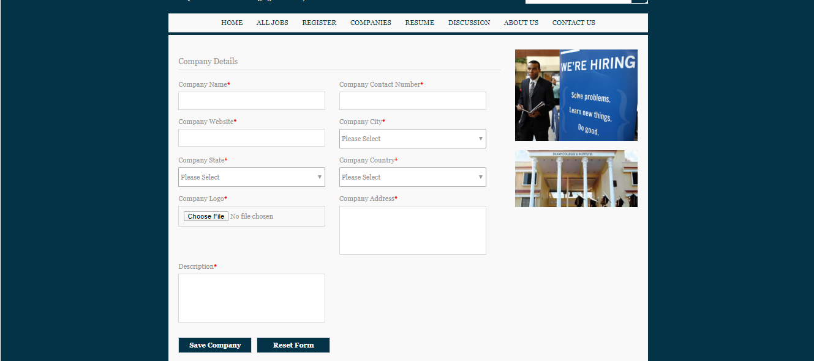

Slide 19
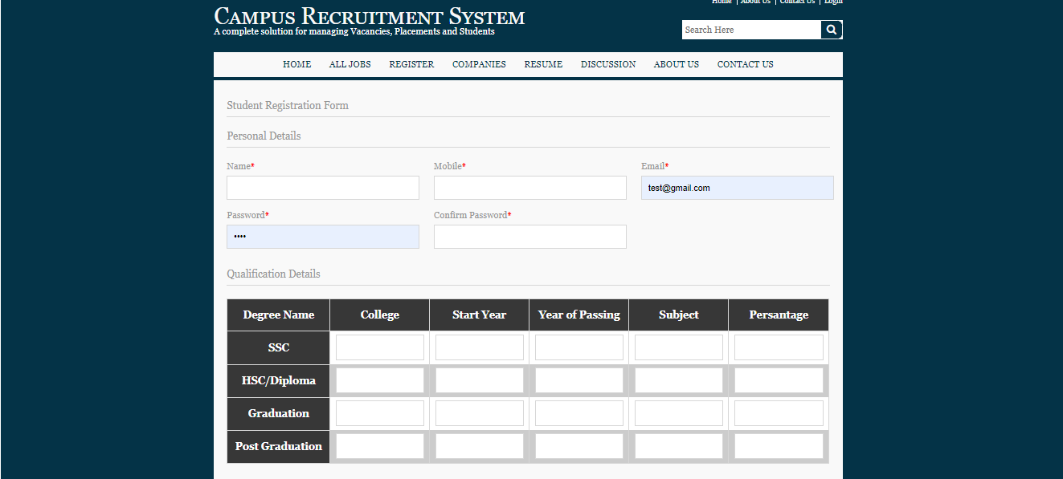
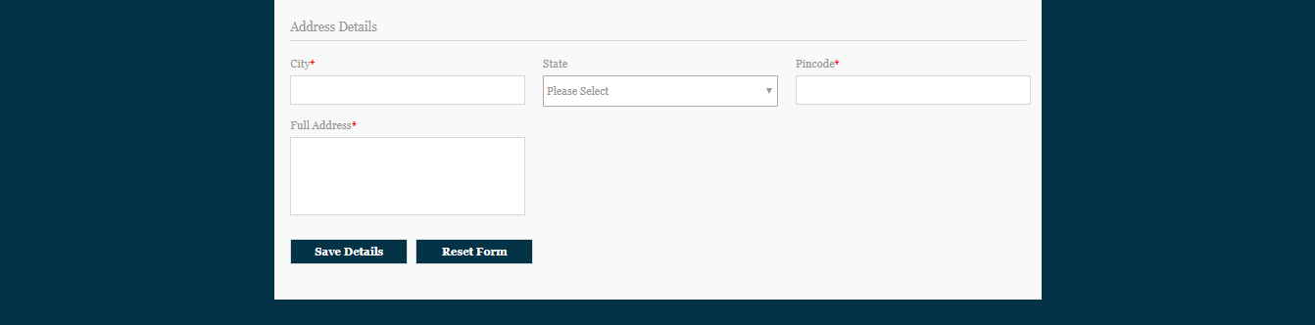

Slide 20
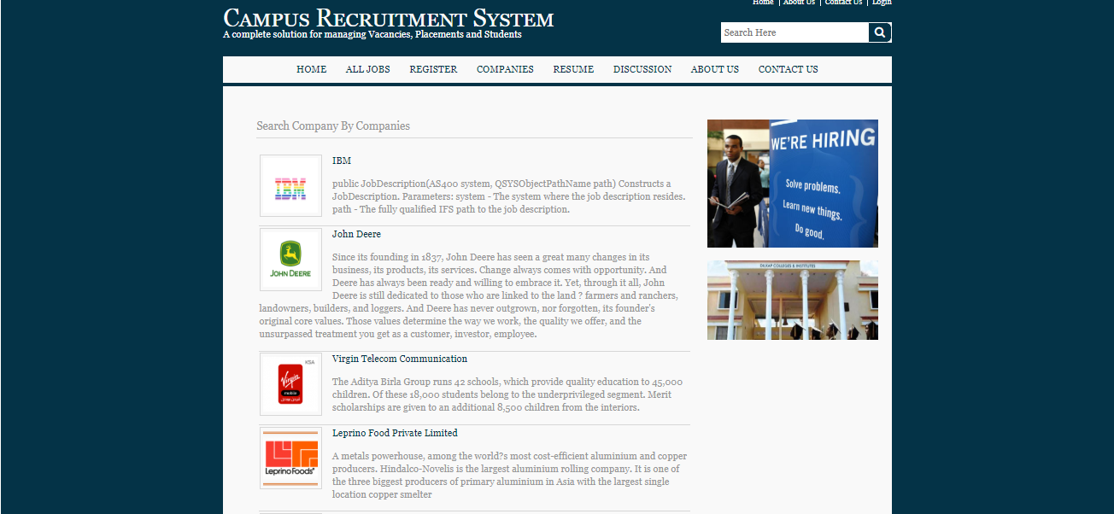

Slide 21
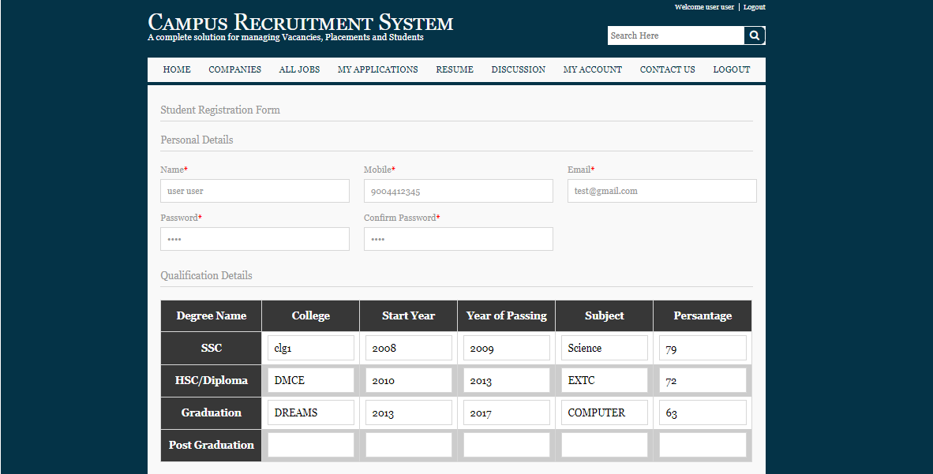
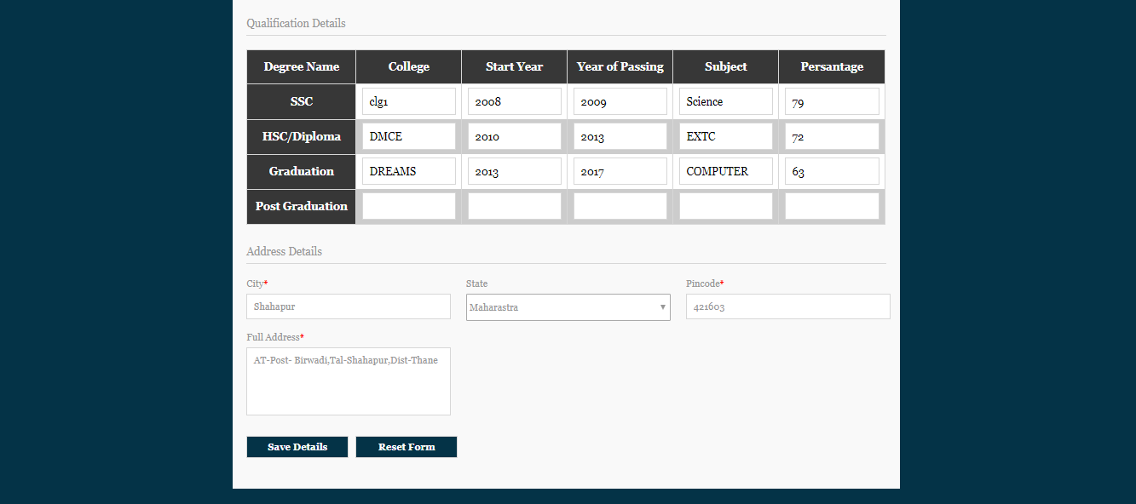

Slide 22
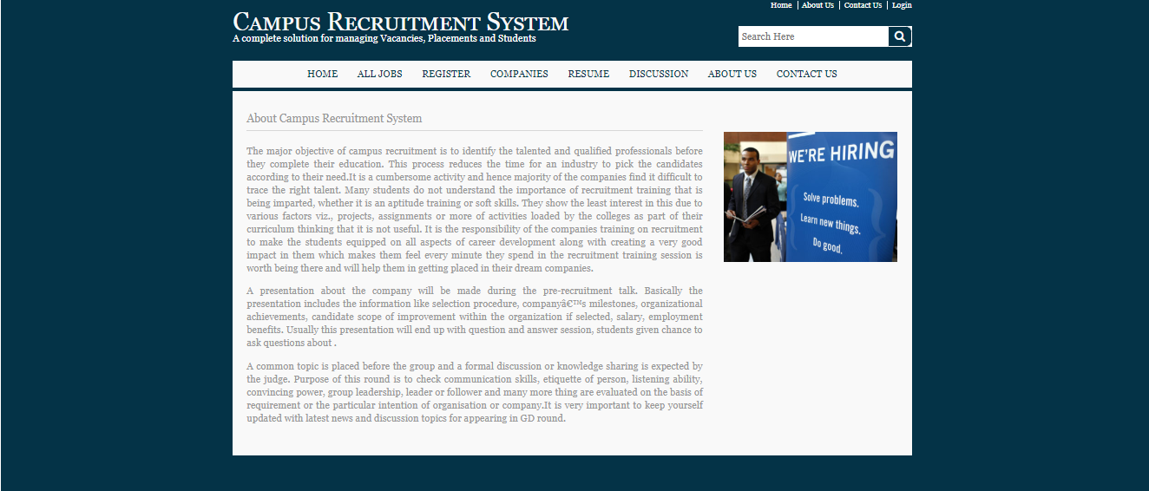

Slide 23
REQUIREMENTS
HARDWARE REQUIREMENTS:
1 GB RAM.
Processor – i3
Hard Disk 5 GB
SOFTWARE REQUIREMENTS:
JAVA
JSP
HTML5
CSS3
JavaScript Bootstrap css
Jquery
Tomcat Server
MySQL DB

Slide 24
ADVANTAGES:-
There will be no need of putting up notice or emailing every student about the company
coming in college. The students can keep updated themselves through this software.
There is admin login that can view and manage both students and company’s account
and also can put up notifications.
This system saves time and efforts.
DISADVANTAGES:-
Student can’t edit their application once sent. It would require admin to change the
data.
It requires large database.

Slide 25
LIMITATIONS OF PRESENT SYSTEM
Recruitment is done manually.
These tasks are time consuming.
It may take one month or long.
People around the world cannot apply.
Online Placement system very convenient because in the manual system there are
lot of difficulties in conducting and managing a recruitment exam, short listing,
maintaining staff etc.

Slide 26
FUTURE ENHANCEMENT
we can send mail to all the students who are eligible for recruitment ,now we send
message to inform students
the admin card(hall ticket)can be provided from the website.
we can show the overall result of students and generate report.
website should be made available for all collages.

Slide 27
CONCLUSION
Presently we designed our Training & Placement Cell to be very User Friendly.
Many features are enhanced to the present Training & Placement Cell.
With this Training & Placement Cell most of the TPO’s time is saved.
The features of the system can be further enhanced in many ways.
The documentation that has enclosed can enable even a person with minimum knowledge to understand it well.

Slide 28
REFERENCE
www.edubridgeindia.com

Slide 29

THANK YOU!!!

